Slide 1




Slide 2
CHAPTER 5 : MANAGING DIVERSITY
GROUP MEMBERS :
Musa Bin Abdullah 233576
M.Musa 233598
M.Muzzamil 233514
M.Arbab 233578
M.Javed 233546

Slide 3
Section 1 :
What is Diversity and
Why it Matters

Slide 4



What is Workplace Diversity?
Simple definition: How people at work are
both different and similar
Two kinds of differences:
Surface: Things you can see (age, race,
gender)
Deep: Things you can't see (values, personality,
how people like to work)
Big change: We moved from just following
laws to seeing diversity as good for business

Slide 5

Why Diversity Helps with People
Better hiring
People stay longer
Fact
Companies that support diversity attract more job applicants
Employees are happier and more committed
Companies with more women in leadership make more money

Slide 6




Why Diversity Helps Performance
Better ideas
Smarter decisions
More creative
Different people bring different solutions
Diverse teams make better choices
Different backgrounds lead to new ideas
Fact: Companies with diverse teams make 19% more money from new ideas

Slide 7
Why Diversity Helps Business Strategy
Understand customers better
Reach new markets
A diverse team understands diverse
customers
Helps companies grow in new areas
Future-ready
Fact
Prepares for changing customer needs
The U.S. is becoming more diverse – companies need to keep up

Slide 8
How Thinking About Diversity Has Changed
01
1960s-70s
02
1980s
Just following laws (like the
Civil Rights Act)
Helping women and minorities
"fit in"
03
1990s
04
Today
Realizing diversity helps business
survive
Using diversity to grow and
succeed

Slide 9
Section 2:
Who is in Today's
Workplace

Slide 10
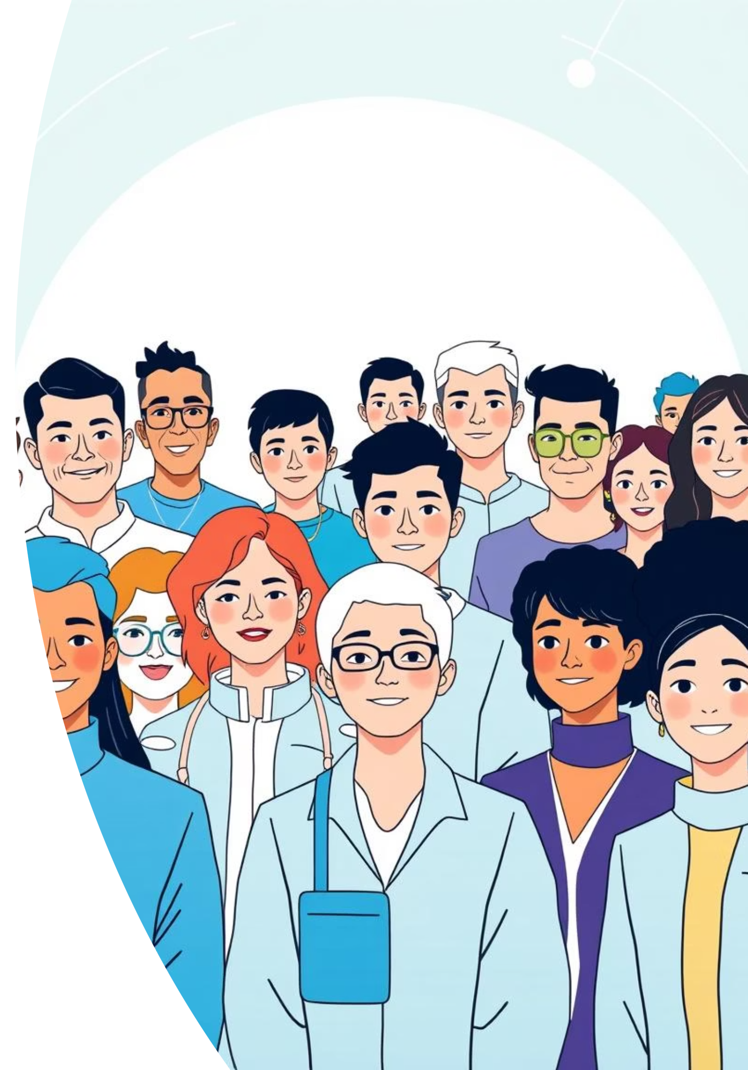
The U.S. is Getting More Diverse
More older people
More people from different backgrounds
White population going down from 72% to
47% by 2050
More foreign-born people: From 14% to 19%

Slide 11
Growing Hispanic Population
Hispanic: People from Spanish-speaking backgrounds
29%
—
—
Big growth
Why it matters
In the workplace
From 12% to 29%
by 2050
Strong buying
power
Largest growing part
of the workforce

Slide 12
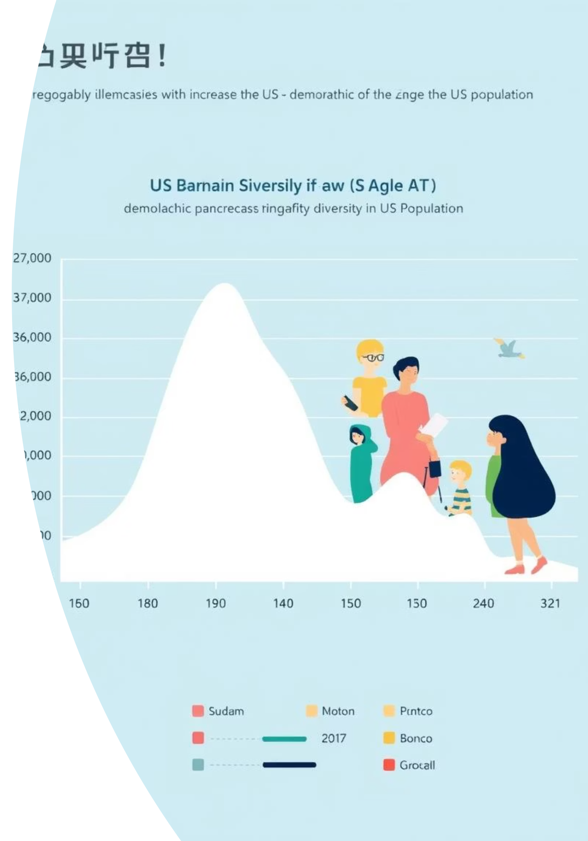
Other Population Changes
Asian population
growing
More diversity
overall
From 4% to 9%
No single majority group
The "average" worker is changing – companies must
adapt.

Slide 13

Types of Diversity at Work
Age
Gender
Younger and older workers
Almost equal men and women at work
Race and ethnicity
Disability
Different backgrounds and cultures
People with different abilities

Slide 14

More Types of Diversity
Religion: Different beliefs and practices
Other differences: Education, experience, where people grew up
All these differences matter in today’s workplace

Slide 15
Section 3 :
Problems with Diversity

Slide 16
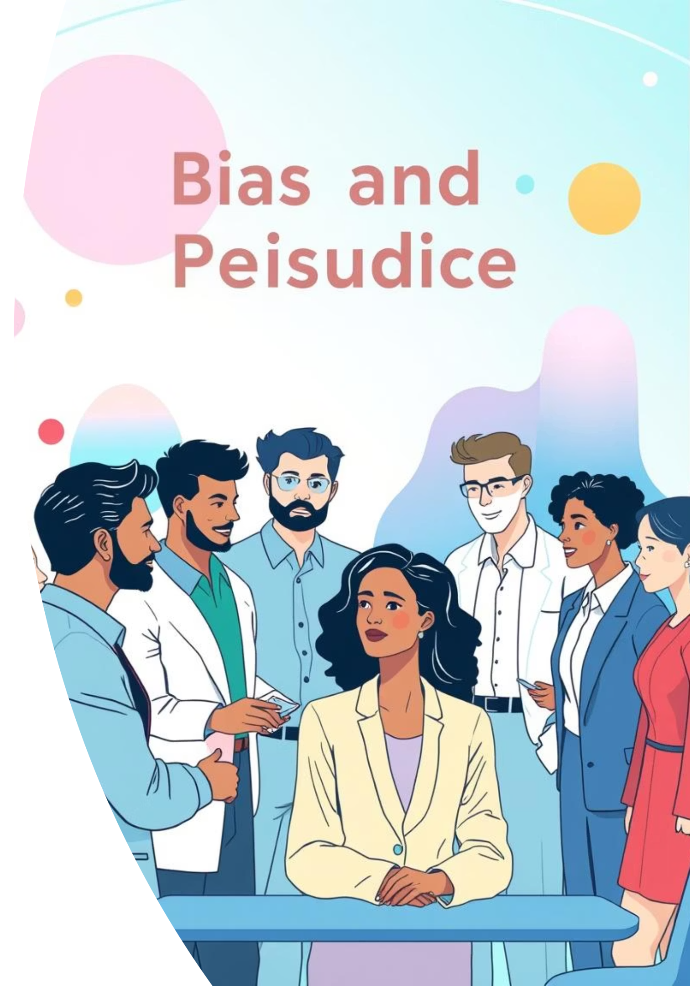
How Bias Works
Bias: Preferring one thing over another
Prejudice: Judging someone before you
know them
Stereotyping: Thinking everyone in a group
is the same
Leads to unfair treatment

Slide 17
Discrimination at Work
Forms include:
Unfair rules
Harassment
Bullying
Mean jokes
Leaving people out
Being disrespectful

Slide 18

The Glass Ceiling
Invisible barrier stopping women and minorities from
top jobs
Fact: Only 4.8% of Fortune 500 CEOs were women
in 2018
Why: Lack of opportunities, unfair ideas about leadership

Slide 19
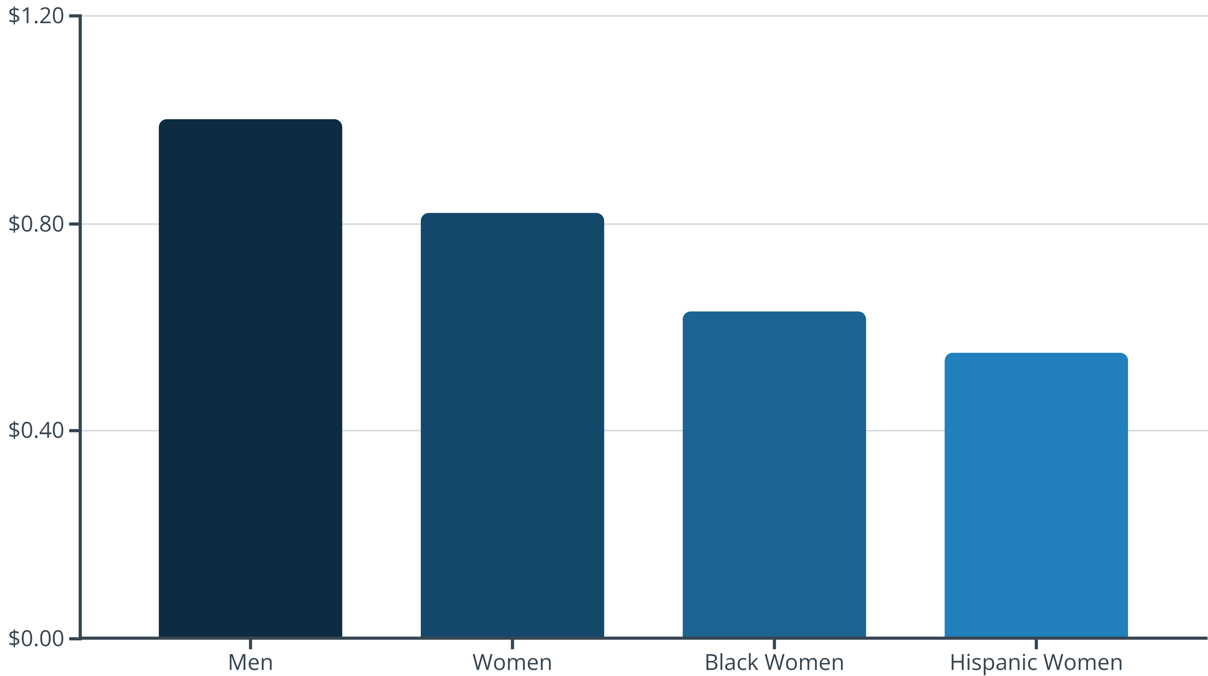
The Pay Gap
Women earn about 82 cents for every dollar
men earn
Worse for Black and Hispanic women
Unfair: Same work should mean same
pay

Slide 20
Wrong Ideas About Disabilities
Myth: Hiring people with disabilities costs too much
Myth: They don't work as well
Myth: They have more accidents
Truth: Most changes cost less than $500
Truth: They work just as well or better
Truth: They often have fewer accidents

Slide 21
Section 4 :
Laws and Solutions

Slide 22
Important Laws About Discrimination
Civil Rights Act
(1964):
Americans with Disabilities Act (1990):
Age Discrimination Act (1967):
No discrimination based on race, color, religion, sex, or origin
No discrimination against people with disabilities
No discrimination against older workers

Slide 23
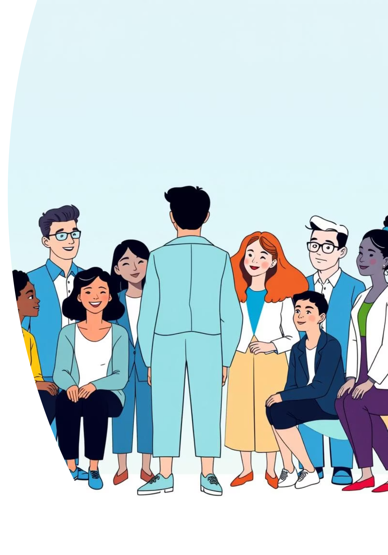
What Leaders Need to Do
Leaders must show they care about diversity
Set the example
Make diversity a business priority
Fact: Works 3x better when leaders support it

Slide 24


Mentoring and Training
Mentoring helps women and minorities get promoted
Diversity training teaches better
teamwork
Example: Marriott trains every month

Slide 25

Employee Resource Groups
Groups of employees with something in common
Examples: Women’s group, veterans group
They support employees and help the company
Fact: 90% of big companies have them

Slide 26
What Works: The Marriott Example
01
02
03
Monthly training
Active support
groups
Leaders speak out against discrimination
Result: Ranked #2 for diversity among big companies

Slide 27
Section 5 :
Questions and Summary

Slide 28
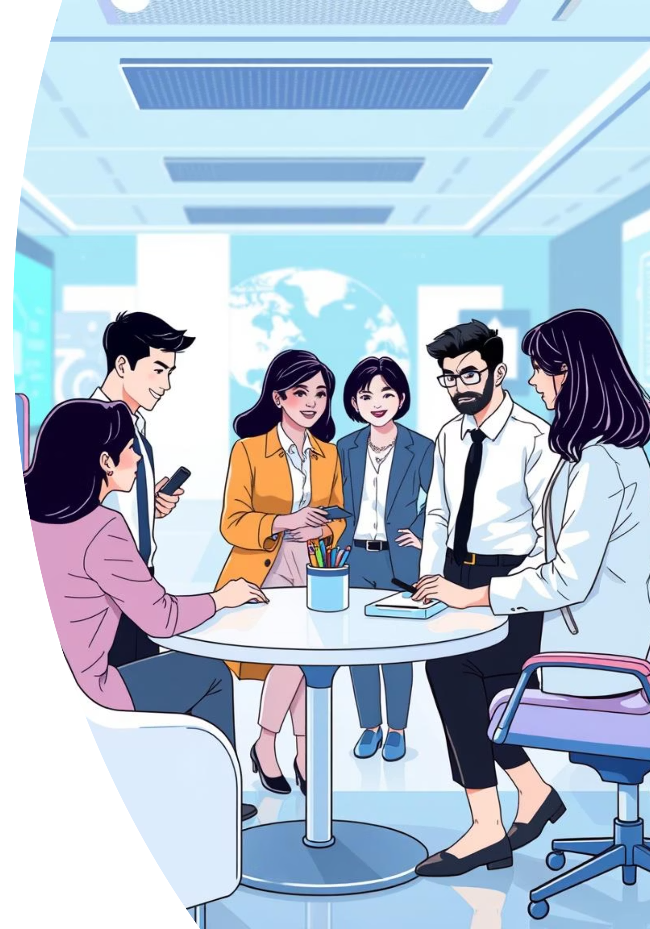
Question 1 – Does Diversity Hurt Teamwork?
Some worry focus on differences hurts teams
Goal: Value differences + stay united
Good companies do both

Slide 29
Question 2 – Does Diversity Mean Lower Standards?
Some think diversity means hiring less qualified people
Truth: It removes unfair barriers
Real goal: Fair chance for everyone

Slide 30

Question 3 – Do Common Practices Hurt Diversity?
Employee referrals hire similar people
Team building may leave people out
Solution: Make practices fair for all
People often recommend
others like themselves,
which reduces diversity.
Some activities can make
certain employees feel
excluded or uncomfortable.
Using fair and equal rules
helps everyone feel included
and supported.

Slide 31




The Bottom Line – Why Diversity Matters
Better talent
More profit
Diversity brings people with different
skills, giving the company better talent.
Diverse teams make smarter decisions,
which helps the company earn more money.
More creativity
Future success
Different ideas from different people lead
to more creative solutions.
A diverse workplace helps the company
grow and succeed in the future.

Slide 32
Chapter 5 – What We Learned
Diversity means differences and similarities
The workplace is becoming more diverse and older
Problems include bias, unfair treatment, invisible barriers
Laws help, but companies must do more
Solutions: Leadership, training, support groups
Goal: A fair workplace where everyone can succeed

Slide 33
THANK YOU
THANK YOU

